Slide 1
Lecture 7: Architectural Design

Slide 2
Architectural design
Architectural design is concerned with understanding how a software system should be organized and designing the overall structure of that system.
Architectural design is the critical link between design and requirements engineering, as it identifies the main structural components in a system and the relationships between them.
The output of the architectural design process is an architectural model that describes how the system is organized as a set of communicating components.

Slide 3
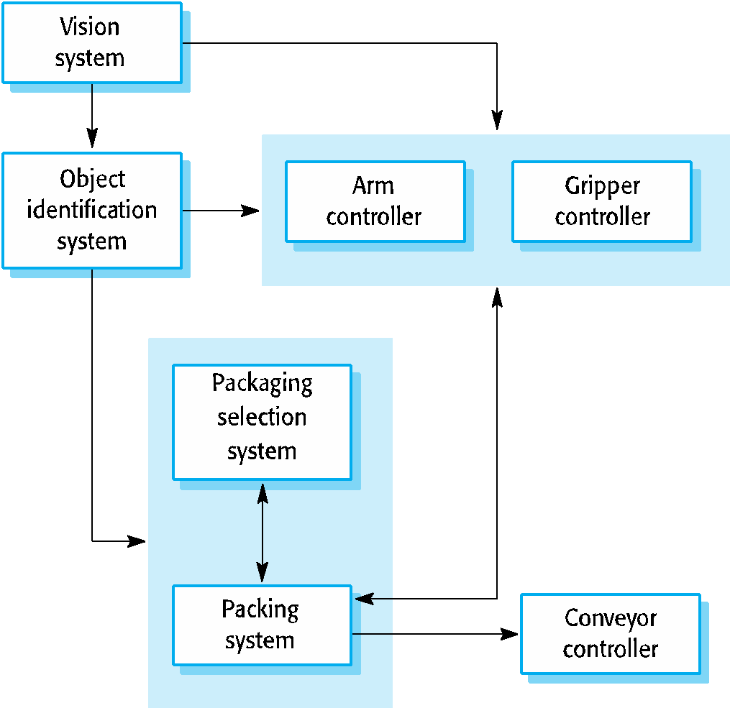
The architecture of a packing robot control system

Slide 4
Architectural abstraction
Architecture in the small is concerned with the architecture of individual programs. At this level, we are concerned with the way that an individual program is decomposed into components.
Architecture in the large is concerned with the architecture of complex enterprise systems that include other systems, programs, and program components. These enterprise systems are distributed over different computers, which may be owned and managed by different companies.

Slide 5
Advantages of explicit architecture
Stakeholder communication
Architecture may be used as a focus of discussion by system stakeholders.
System analysis
Means that analysis of whether the system can meet its non-functional requirements is possible.
Large-scale reuse
The architecture may be reusable across a range of systems
Product-line architectures may be developed.

Slide 6
Architecture and system characteristics
Performance
Localise critical operations and minimise communications. Use large rather than fine-grain components.
Security
Use a layered architecture with critical assets in the inner layers.
Safety
Localise safety-critical features in a small number of sub-systems.
Availability
Include redundant components and mechanisms for fault tolerance.
Maintainability
Use fine-grain, replaceable components.

Slide 7
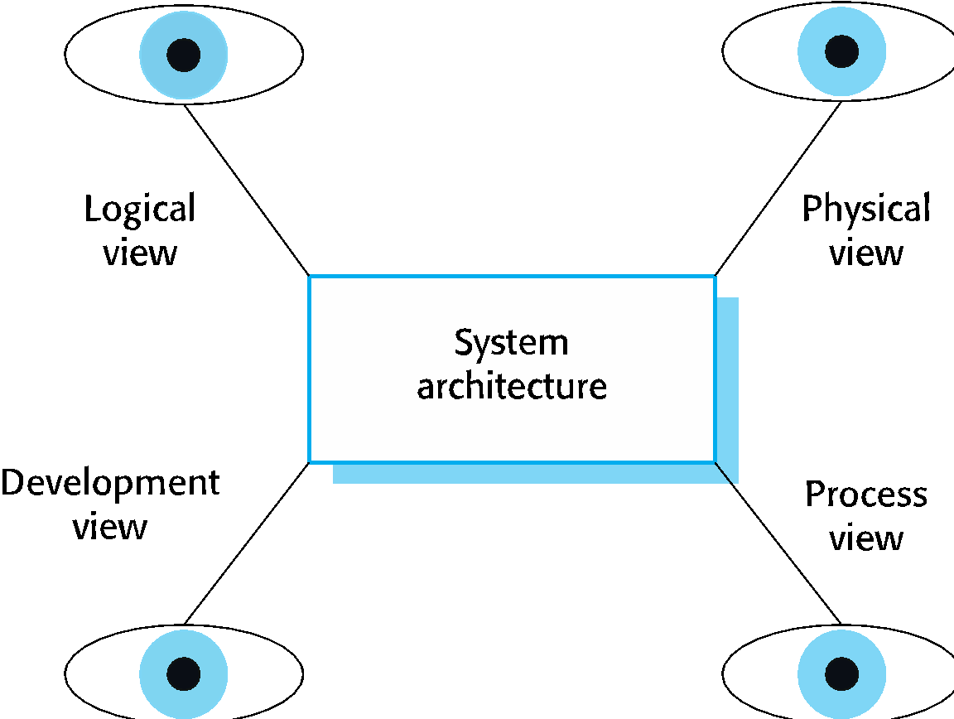
Architectural views

Slide 8
Model of software architecture
A logical view, which shows the key abstractions in the system as objects or object classes.
A process view, which shows how, at run-time, the system is composed of interacting processes.
A development view, which shows how the software is decomposed for development.
A physical view, which shows the system hardware and how software components are distributed across the processors in the system.
Related using use cases or scenarios (+1)

Slide 9
Architectural patterns
Patterns are a means of representing, sharing and reusing knowledge.
An architectural pattern is a stylized description of good design practice, which has been tried and tested in different environments.
Patterns should include information about when they are and when the are not useful.
Patterns may be represented using tabular and graphical descriptions.

Slide 10
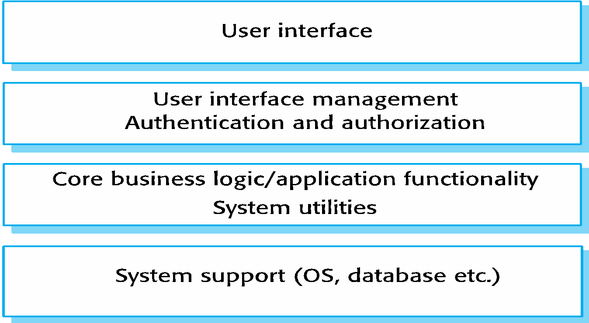
A generic layered architecture

Slide 11
Client-server architecture
Distributed system model which shows how data and processing is distributed across a range of components.
Can be implemented on a single computer.
Set of stand-alone servers which provide specific services such as printing, data management, etc.
Set of clients which call on these services.
Network which allows clients to access servers.

Slide 12
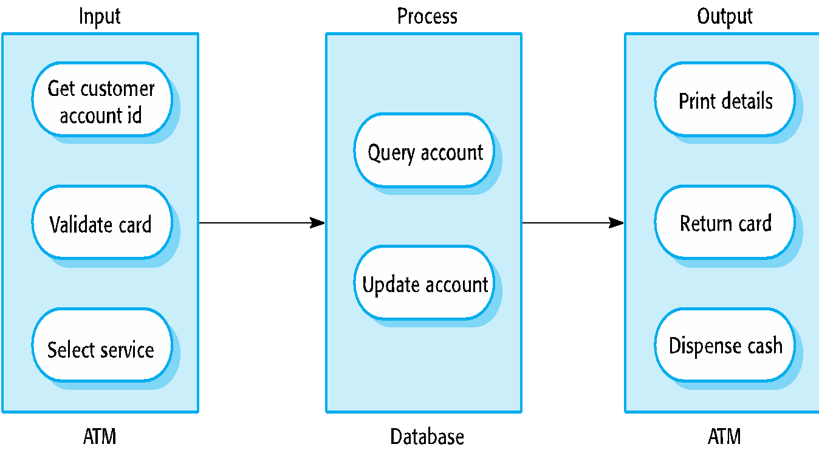
The software architecture of an ATM system

Slide 13
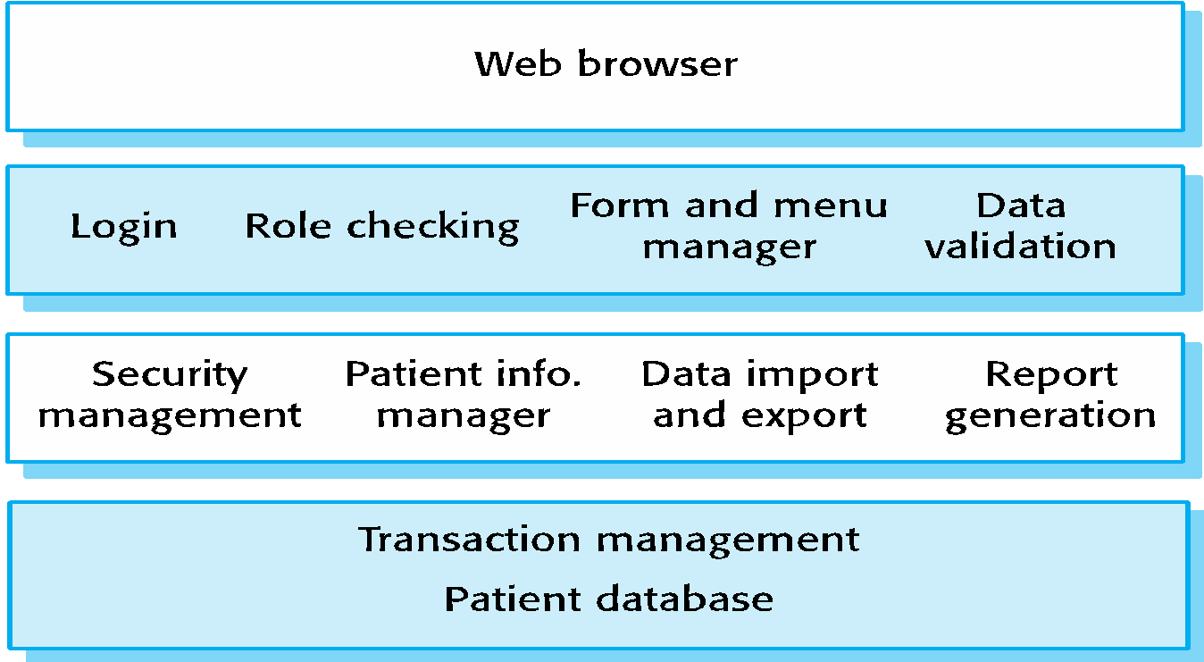
The architecture of the Mentcare system

Slide 14
Server implementation
These systems are often implemented as multi-tier client server/architectures
The web server is responsible for all user communications, with the user interface implemented using a web browser;
The application server is responsible for implementing application-specific logic as well as information storage and retrieval requests;
The database server moves information to and from the database and handles transaction management.

Slide 15
Compiler components
A semantic analyzer that uses information from the syntax tree and the symbol table to check the semantic correctness of the input language text.
A code generator that ‘walks’ the syntax tree and generates abstract machine code.

